Slide 1
CS0449: Introduction to System Software
SHINWOO KIM
Shinwoo Kim
Teaching Assistant
shinwookim@pitt.edu
https://sites.pitt.edu/~shk148/
Spring 2023, Term 2234
Friday 12 PM Recitation
Jan 27th, 2023
with materials from
Luis Oliveira, Jon Misurda, and
and Suzanne Matthews et al.’s
Dive into Systems
Department of Computer Science
School of Computing & Information
University of Pittsburgh
REC-1: Basic of C Programming
Announcements
Basic Input/Output using C standard library functions
Lab 1: Data and Pointers

Slide 2
Announcements
Slides/Example code can be found: https://sites.pitt.edu/~shk148/teaching/CS0449-2234/#handouts
Link in Discord (#announcements)
TA Office Hours Finalized
Updates will be posted to Discord
Day | Time/Location
Monday | 1:00 PM - 2:30 PM @ 5806 SENSQ
Tuesday | 3:00PM - 3:45PM @ 5712 SENSQ
Wednesday | 2:30PM @ 5710 SENSQ
Thursday | 1:00PM - 3:45PM @ 6408 SENSQ
Friday | 11:00AM - 12:00PM @ 5806 SENSQ
By appointment | Message me to schedule a meeting (in-person/virtual)

Slide 3
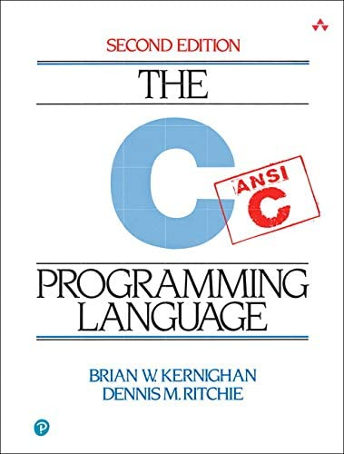
C Programming
Basic Input/Output using the C Standard Library

Slide 4
Standard C Library (libc)
In Lab0, you used printf() in the Hello World program
> printf("Hello world! x is currently %d \n", x);
> Hello world! x is currently 2
printf() stringified the arguments and printed to the standard output
formatted the string and filled-in the placeholders (e.g., %d)
Notice we didn’t need to implement that printf() function ourself
printf() is a function built-in to C’s standard I/O library
Hence, we needed to tell our compiler to make use of the standard library functions with #include <stdio.h>
You will talk about how the libraries are linked to your code in lecture soon
Notes:
stdout → the terminal

Slide 5
man gives us information about functions, commands, libraries
On most Unix/Unix-like systems, you can use man to learn more about functions/commands/etc.
The manual has the most accurate information about all the library functions, programs, commands, etc.
> Man printf
SCANF(3) Library Functions Manual SCANF(3)
NAME
printf, fprintf, ... , vsnprintf - formatted output conversion
SYNOPSIS
#include <stdio.h>
int printf(const char *restrict format, ...);
...
DESCRIPTION
The functions in the printf() family produce output according to a format as described below
...
If you are having trouble running man on Thoth
try: MANPATH= man 3 scanf

Slide 6
Detailed look at using printf()
int printf(const char * format string, ...);
Returns an integer: number of characters printed (excluding null terminator)
Remember, in C, a string is just an array of characters
We place placeholders which begin with a percent sign (%). The variables which comes after the formatter will replace the placeholders when printing
#include <stdio.h>
int main()
{
printf("Name: %s, Info:\n", "John");
printf("\tAge: %d \t Ht: %g\n", 20, 5.9);
printf("\tYear: %d \t Dorm: %s\n", 3, "Towers");
return 0;
}
Name: John, Info:
Age: 20 Ht: 5.9
Year: 3 Dorm: Towers

Slide 7
Reading Input using scanf()
Like printf(), scanf() is another C standard library function
Used to read character, string, numeric data from keyboard
Again, if you want to use it in your program you have to include the header ( #include <stdio.h> )
int scanf(const char * format, ...)
Returns an integer: number of input items successfully matched and assigned
Passes by reference (a pointer) to the variable which will hold our input
Defines what we are reading (character? Integer? Float?)

Slide 8
Example code using scanf() _{(live demo)}
#include <stdio.h>
int main()
{
char ch;
int x;
printf("Enter any character \n");
scanf("%c", &ch);
printf("Entered character is %c \n", ch);
printf("Enter any integer\n");
scanf("%d", &x);
printf("Entered integer is %d", x);
return 0;
}
http://sites.pitt.edu/~shk148/teaching/CS0449-2234/code/scan.c.html

Slide 9
Lab 1: Data and Pointers
Practicing with data and input

Slide 10
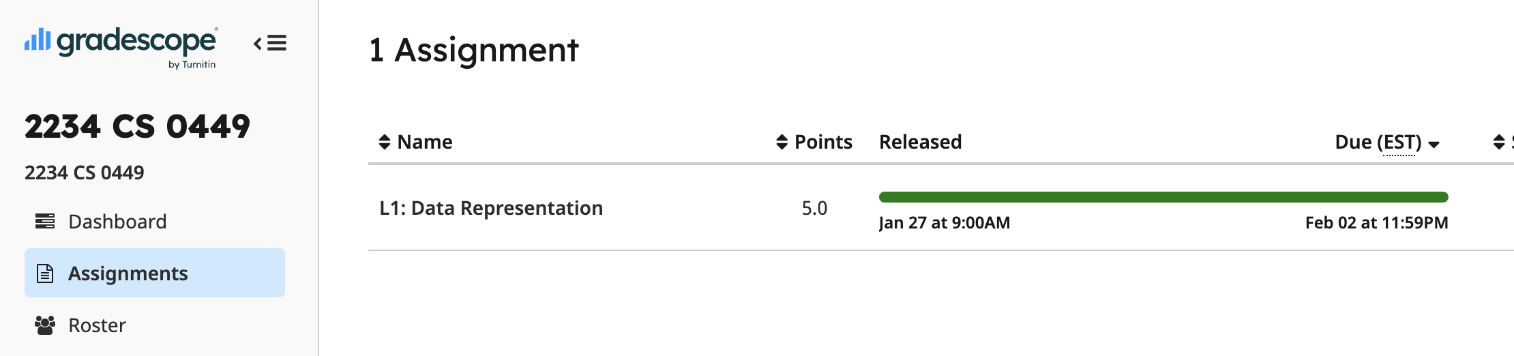
Part A: Practicing Data and Bitwise Manipulation
Collaboration: You are encouraged to work with one other person.
Your partner must be in the same recitation section
Select your partner’s name on Gradescope
Part A – Problems
See L1: Data Representation on Gradescope
Multiple choice, fill-in-the-blank type of questions

Slide 11
B1: Understanding sizeof()
TODO: Write a program that prints the size of three structs
REQUIREMENTS: create two files (size.c, size.h)
size.c has your implementation
size.h contains the structs
Expected output:
The size of struct A is #
The size of struct B is #
The size of struct C is #
See Lab Handout for how to create struct A, B, and C
Hint: The special 'sizeof()' macro gives us the byte size.
Also, remember to include the header file(s) in your .c file
#include “header.h” (for your header files)
#include <header.h> (for standard libraries)

Slide 12
B2: Understanding ternary operators
TODO: Implement the function ternary in ternary.c
int ternary(int cond, int true_value, int false_value) { /*...*/
}
Cannot use the ternary operator
Output of ternary should be the same as: cond?true_value:false_value
VARIABLE = COND ? TRUE_VALUE : FALSE_VALUE
VARIABLE == ternary(COND, TRUE_VALUE, FALSE_VALUE)
The condition to be tested (returns true/false)
The value to be returned if the condition is true
The value to be returned if the condition is false
In C, FALSE == 0; TRUE != 0 (usually TRUE == 1 but not always)

Slide 13
B3: Creating a simple calculator
Sample output:
Requirements
Create 1 files: calculator.c
Inputs must be read from keyboard (use scanf())
Support the following operations:
+, -, *, /, %(mod)
& (bitwise and), ~ (bitwise not)
Your output must match the sample output
Enter your calculation:
3 + 4
> 3 + 4 = 7
Enter your calculation:
3 c 4
Invalid calculation! "3 c 4"
User Input
HINT: Take a look at calculator.c from Lab0

